Slide 1
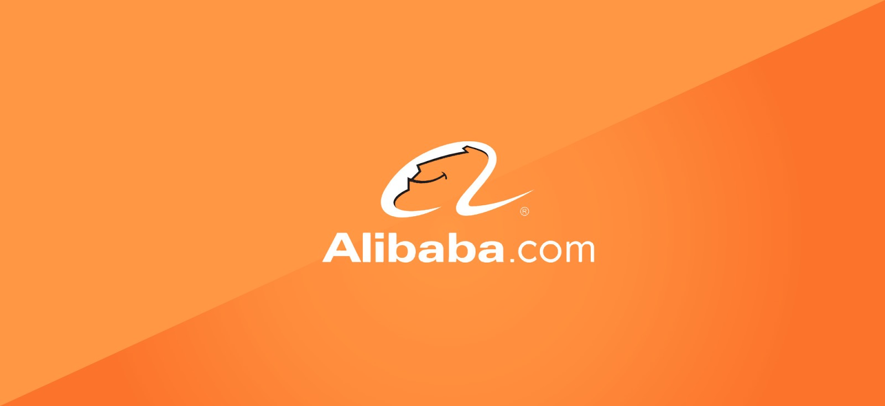
KRISTINA UDASH
.
ISHWOR KHATIWADA
KAMAL KOIRALA
.
GYANENDRA SAUD
KESHAB DHUNGANA
A CASE STUDY

Slide 2
01 – HISTORY & BACKGROUND
ISTORY &
BACKGROUND
05 - ALIPAY
02 –ALIBABA GROUP
06 –SUCCESS
FACTORS
Table of Contents
03 – alibaba.com
07 – REVINUE
compititors
.
04 -Taobao.com
08 – Challenges
Conclusion
Notes:
© Copyright Showeet.com

Slide 3
Background and History
Alibaba.com, a member of the Alibaba Group of companies.( Alibaba, Taobao, Ali-express, Alipay)
The company was founded in 1999 by 18 people led by jack ma.
The English language website www.alibaba.com specializes in B2B trades especially for international buyers trying to connect to Chinese sellers.
SERVICES:
E-commerce, Cloud computing, Entertainment
Mobile commerce ,Retail ,Mobile media ,Films , TV shows.

Slide 4
Alibaba Group
Alibaba Group Holding Limited (also known as Alibaba Group is a Chinese multinational specializing in e-commerce, retail, Internet, and technology.
The company provides consumer-to consumer/C2C),business-to-consumer (B2C/online retailers), and business-to-business (B2B/Direct to Consumer).
services via web portals, as well as electronic payment services , shopping search engines and cloud computing services.

Slide 5
Companies Under Alibaba
Logistics
Cloud Computing
Finance
Digital
Entertainment
Chinese Retail Marketplaces
Wholesale Commerce
Ant Financial
(includes Alipay)
MY bank
Taobao Marketplace
Tmall
Rural Taobao
1688.com (China)
Alibaba.com (global)
Cainiao Network
Alibaba Cloud
Alibaba Pictures
Alibaba Music
Alibaba Sports
UC browser

Slide 6
Alibaba
Alibaba is the largest retailing and ecommerce company of China and is listed in fourth positions in the world in current status with absolute amazing progress for it’s wide ranges.
It is a B to B platform – Business to Business
It shares out it’s product on especially the business man of other countries like India, Pakistan, Thailand and many more
For the use of Chinese business man, it has it’s own domestic site called 1688
In year Alibaba’s revenue from it’s core commerce was $56.2 billion.
It’s sales and profit is more than that of amazon and eBay.
it’s called ‘Amazon of China’.

Slide 7

Taobao
It was started in 2003 whose name in Chinese means “to find treasure’ and is a B to B and B to C platform.
It is the online business where anyone can but and sell products.
It contains more than 1 billion products listed.
It also furthermore has extended it’s services into three parts-
Taobao, Tmall and etao.
etao is search engine and comparision website.
In tmall, the Chinese as well as other international companies sell mostly the branded goods

Slide 8

AliPay
60%
Third-party mobile and online payment platform
The service was first launched in 2003
Operates with more than 65 financials Visa and MasterCard
Provides multiple security
QR-code
payment

Slide 9
WHY SUCCESSFUL ?
It’s a Platform to support small and medium sized enterprises (SMEs).
Alibaba.com also offers its members and other SMEs import/export supply chain services, including customs clearance, trade financing and logistics services.
The key benefits of using alibaba.com are such as Low cost, Access to many suppliers/buyers, Quick transaction time, More transparency in transaction, Lower risk of fraud.
facilitate business-to-business sales, business-to-consumer sales and consumer-to-consumer sales .

Slide 10
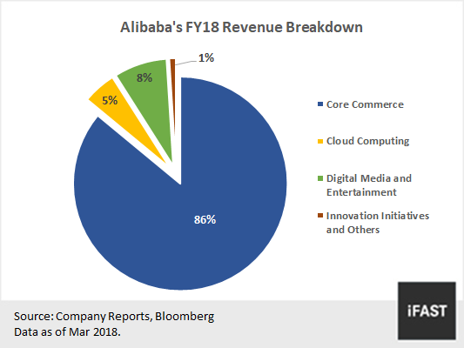

Slide 11
Struggle's and challenges
PLACE/DISTRIBUTION STRATEGIES
PRODUCT/SERVICE STRATEGIES
logistic services
Shipping servies
Global website
Domestic website
C to C platform(Taobao)
MARKETING STRATEGIES
PRICING STRATEGIES
Gold Supplier
Real time statistical tool
Differentiated
targeting strategy
SWOT Analysis
strengths, weaknesses, opportunities, and threats
DATA AND SECURITY
Clouud Act

Slide 12
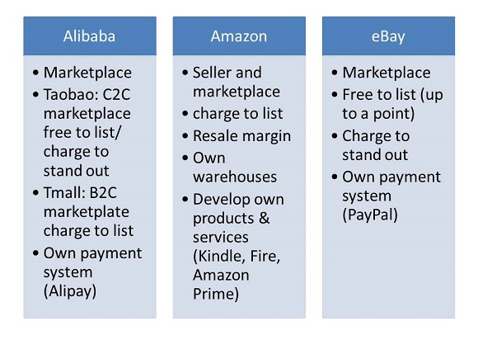
Compititors

Slide 13
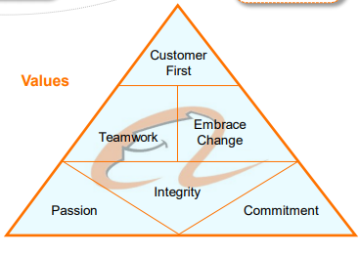
CONCLUSION AND VISION
Alibaba.com has grown admirably from its initial beginnings as a small E-Marketplace into a giant e-Marketplace.
The four Ps(product, price, place, and promotion) of the marketing strategies have contributed to the success of Alibaba.com.

Slide 14
References
en.wikipedia.org/wiki/Alibaba_Group
https://www.alibaba.com/
www.bbc.co.uk/news/topics/alibaba
https://www.ukessays.com/essays/marketing/the-alibaba-group-company-analysis-marketing-essay.php
https://www.marketing91.com/marketing-strategy-alibaba/

Slide 15

THANK YOU

